Slide 1


Slide 2



CODE VERSE HACKATHON 2025
Problem Statement Title- 10: Manual Dashboard Distribution
Team Name - Bug Busters
Team Members- Riddhi Sawant, Abhiraj Mukadam, Sarvesh Patil, Yug Shah

Slide 3
IDEA TITLE
Proposed Solution:
Detailed explanation of the proposed solution :
InsightHub is a centralized, secure web platform that replaces the manual process of creating and emailing reports.
It shifts the paradigm from a static, push-based system (emailing PDFs) to a dynamic, pull-based model where stakeholders can access live data on demand.
As illustrated in our Solution Flow Diagram (Image 1/2), the journey begins with "Start" and immediately leads to a "Live Interactive Dashboard."
Stakeholders log in to a personalized portal and view real-time data through interactive charts and graphs, tailored specifically to their role and permissions.
Innovation and uniqueness of the solution:
Self-Service Interactivity: Directly supported by the "Live Interactive Dashboard" block, enabling "Interactive Charts and Graphs," "Filters for Data Exploration," and overall "Stakeholder Self-Service."
Proactive AI-Powered Alerts: This innovative feature is captured in the "Proactive AI-Powered Alerts" block, featuring "Anomaly Detection Alerts" and "Natural Language Insights."
Role-Based Personalization: Clearly depicted in the "Role Based Access Control" block, ensuring specific access for "Marketing Manager Access," "Executive Access," and "Client Access."
How it addresses the problem:
Eliminates Delays: The "Automated Data Pipeline" section in our diagram highlights how we "Fetch Data from Ad Platforms" and ensure "Hourly Updates," completely removing manual generation and distribution bottlenecks.
Ensures Accuracy: The pipeline also explicitly aims to "Eliminate Manual Errors" by connecting directly to source APIs.
Increases Efficiency: It frees up employees from the repetitive, time-consuming task of report creation, allowing them to focus on high-value analysis and strategy.

Slide 4
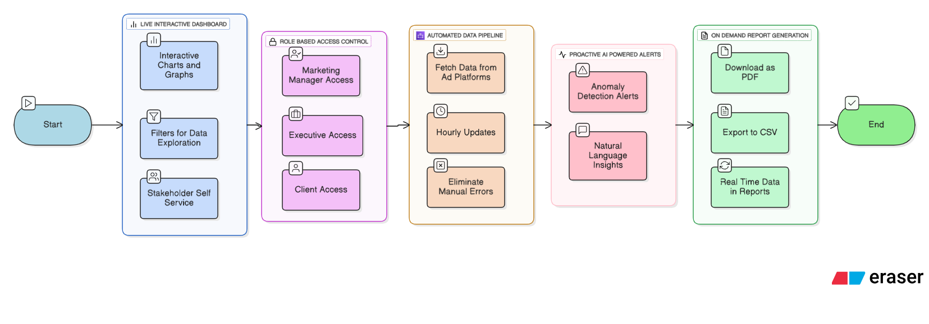
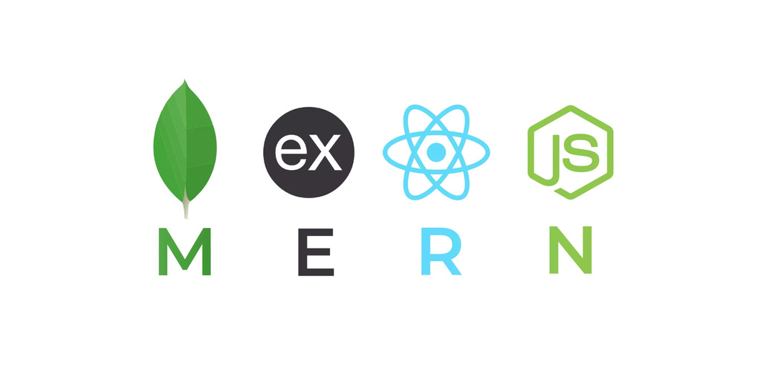
TECHNICAL APPROACH
Tech Stack and Workflow
Programming Language | Frameworks/Libraries | Database/Storage
JavaScript, Python | React.js, Material UI, Recharts, Node.js, Express.js, Socket.IO | MongoDB

Slide 5
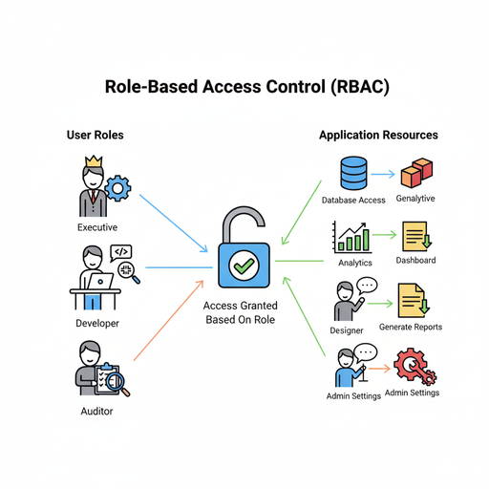
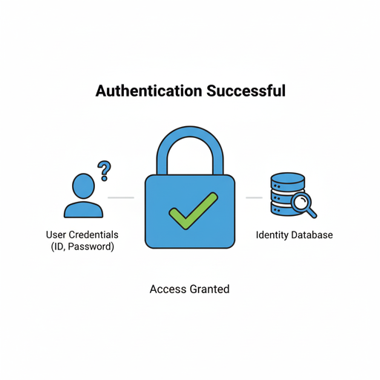
TECHNICAL APPROACH
Workflow : The User Interaction
This is what a stakeholder experiences when they use the platform.
Secure Login: A user navigates to the InsightHub portal and enters their credentials. The React frontend sends this information to the Express server.
Authentication & Authorization: The server verifies the user's credentials against the MongoDB user collection. Upon success, it generates a secure JSON Web Token (JWT) containing the user's ID and role (e.g., 'Executive', 'Manager'). This token is sent back to the browser.
Role-Based Dashboard Rendering: The user is redirected to their dashboard. The React application makes an initial request to the server for data, sending the JWT along for authorization. The server validates the JWT, checks the user's role, and fetches only the specific data that the role is permitted to see from MongoDB.
Establishing Live Connection: As the dashboard loads, the React client establishes a persistent connection with the Socket.IO server and begins "listening" for the "data-updated" event.
Interactive Exploration: The user views their personalized dashboard with interactive charts and KPIs. They can use filters (e.g., date range, campaign) to explore data. Each filter change triggers a new API request to get a specific slice of data from the server.
Receiving Live Updates: While the user is viewing the dashboard, the backend pipeline (Workflow 1) might complete its hourly run. The server emits the "data-updated" event. The user's dashboard, listening for this signal, receives it instantly. This triggers an automatic re-fetch of the data from the server, and the charts and numbers update on the screen in real-time, without requiring a page refresh.
On-Demand Reporting: If a user needs a static copy, they can click a "Download as PDF" button. This action sends a request to the server, which generates a PDF of the user's current dashboard view and sends it back for download.

Slide 6
FEASIBILITY AND VIABILITY
Feasibility Analysis :
The project is highly feasible within a 24-hour timeframe because the MERN stack is designed for rapid prototyping. Using JavaScript across the entire application reduces context-switching and speeds up development. Furthermore, by leveraging cloud services like MongoDB Atlas for the database and Vercel for deployment, we offload complex infrastructure management and can focus entirely on building our core features.
Potential Challenges and Risks
API Integration: Securing developer keys and understanding the specific data structures and rate limits of external ad platform APIs under a tight deadline can be a significant bottleneck.
Time Constraint vs. Scope: The primary challenge is balancing a functional Minimum Viable Product (MVP) with our ambitious "wow-factor" features like real-time Socket.IO updates and AI alerts.
Data Normalization: Data from different sources often has varied formats. The task of transforming this data into a single, consistent structure for our database is a non-trivial effort that can consume valuable time
Strategies for Overcoming These Challenges
Develop with Mock Data: We will start by using a well-defined mock JSON file. This decouples our frontend and backend work, allowing the UI to be built completely in parallel while the backend team works on live API integration.
Adopt a Strict MVP-First Approach: Our primary goal is a demonstrable end-to-end user journey: login, view a dashboard, and see an update. Advanced features like PDF generation are stretch goals to be addressed only after the core functionality is stable.
Focus on a Single Data Source: To prove the concept, our hackathon prototype will perfect the data pipeline for one single ad platform. This demonstrates the solution's viability without getting delayed by the complexity of handling multiple data sources.

Slide 7

IMPACT AND BENEFITS
Potential impact of the solution
This solution fundamentally transforms the organization's reporting culture from being slow and reactive to fast, proactive, and data-driven. It democratizes data access, allowing stakeholders at all levels to make better, faster decisions based on real-time information.
Benefits of the solution:
Boosts Operational Efficiency: Frees up 12-15% of a data analyst's monthly bandwidth by cutting 95% of the time spent on manual reporting. This allows skilled employees to focus on strategic analysis and growth initiatives rather than repetitive data entry.
Improves Marketing ROI: Improves return on investment (ROI) by an estimated 5-10%. The real-time alerts enable teams to identify and pause underperforming campaigns up to 48 hours faster, minimizing wasted ad spend and allowing for quicker budget reallocation to winning campaigns.
Increases Data Engagement: Projects a 300% increase in stakeholder engagement with performance data. This is achieved by shifting from a passive model (skimming a weekly email) to an active, self-service model where users explore the interactive dashboard daily to answer their own questions.
Enhances Decision Confidence: Achieves 100% data accuracy by eliminating manual copy-paste and export errors. This builds universal trust in the numbers, leading to faster, more confident strategic decisions without the need for secondary validation.
Reduces Reporting Costs at Scale: Reduces the marginal cost of reporting for each new client or campaign by over 99%. The automated system is built to scale, handling hundreds of campaigns with virtually zero additional manual effort, directly supporting business growth without increasing overhead.

